Slide 1
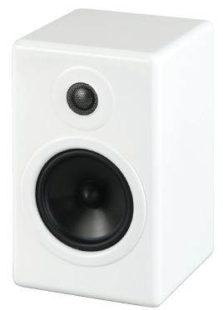
Dmitry Ignatyev Supervisor: Benn Thomsen
Loudspeaker acoustics measurement and automated digital active cross-over design

Slide 2
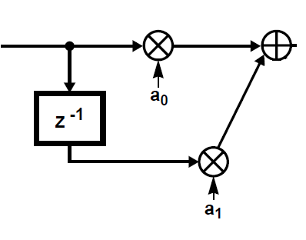
Walls
Advantages:
One amplifier channel per loudspeaker
Good for all-analogue
Disadvantages:
Large passive components
Power losses
Inflexible
Electromechanical coupling
M
Reflections
PA
SPKR
Power losses
Walls
Advantages:
Flexible filters
Lower power requirements
Linear phase possible
Disadvantages:
Multiple amplifier channels per loudspeaker
Reflections
DAC
SPKR
+PA
Digital equaliser +
cross-over
HP/LP

Slide 3
Walls
Electromechanical coupling
M
Reflections
Digitally stored sound
D/A
PA
SPKR
Power losses
Walls
Reflections
Digitally stored sound
D/A
SPKR
+PA
Digital equaliser +
cross-over
HP/LP

Slide 4
Room response correction
Room impulse response simulation:
Ray tracing algorithm
Material dependent reflections
Does not account for diffraction or diffuse reflections
Simulation
Real impulse response
Simulation did not produce accurate results
Non-minimum phase - direct inversion impossible

Slide 5
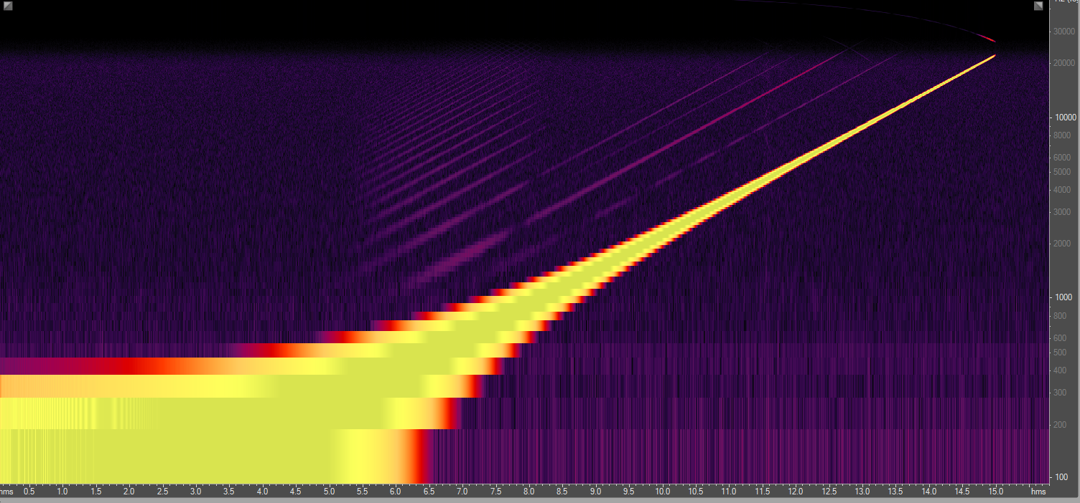
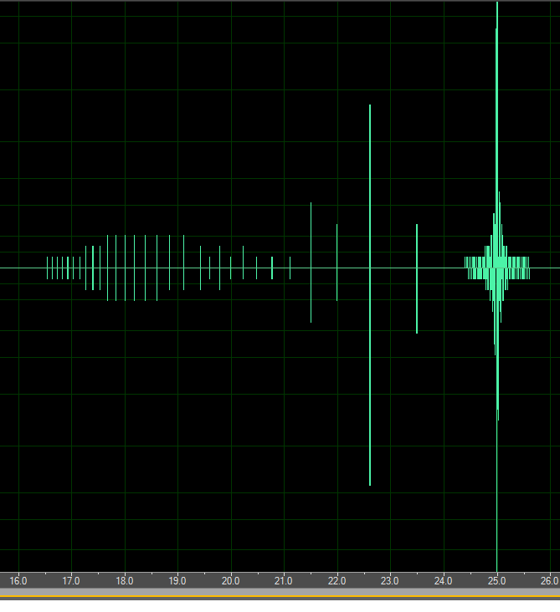
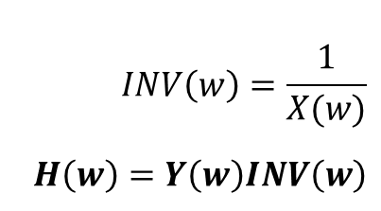
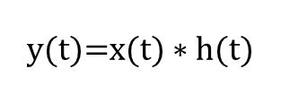
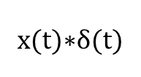
Characterisation of the impulse response
cross-over +
speaker +
room
x(t)$∗$δ(t)
h(t)
y(t)=x(t) $∗h(t)$
inv(t)
h(t)
Convolution
Deconvolution
$$INV\left(w\right)=\frac{1}{X(w)}$$
$$H\left(w\right)=Y\left(w\right)INV\left(w\right)$$
$x\left(t\right)=\sin\left(K\left(e^{\frac{t}{L}}−1\right)\right)$ $w\left(t\right)=\frac{d}{dt}\left(K\left(e^{\frac{t}{L}}−1\right)\right)=w_{1}e^{\frac{t}{T}ln\left(\frac{w_{2}}{w_{1}}\right)}$
Time

Slide 6
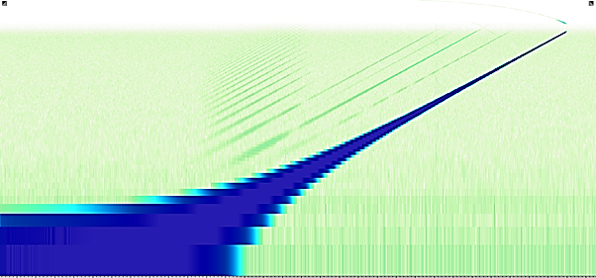
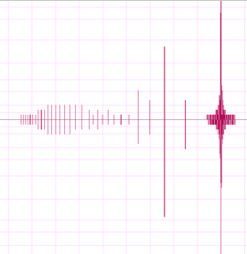

Slide 7
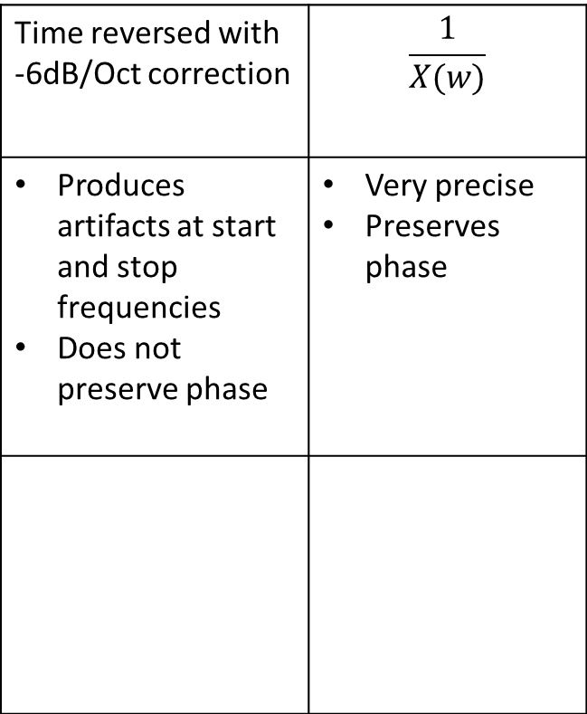
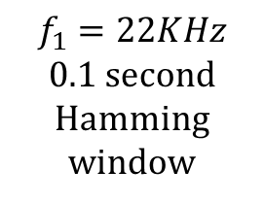
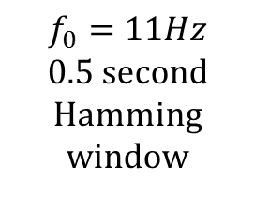
System realisation
Possible inverse signals, inv(t)
Time reversed with -6dB/Oct correction | $$\frac{1}{X(w)}$$
Produces artifacts at start and stop frequencies Does not preserve phase | Very precise Preserves phase
$$f_{0}=11Hz$$
0.5 second Hamming window
Length:
15 seconds
$$f_{1}=22KHz$$
0.1 second Hamming window
x(t)
Line out
Circuit under test
H(w)
y(t)
Mic in
Op-amp buffers

Slide 8
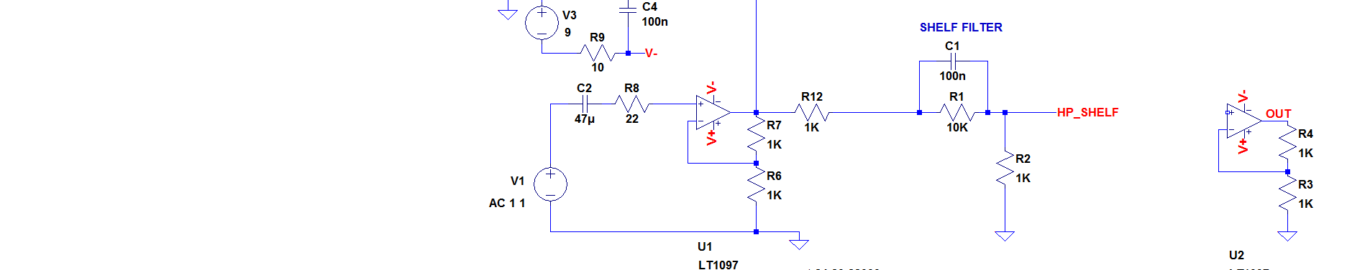
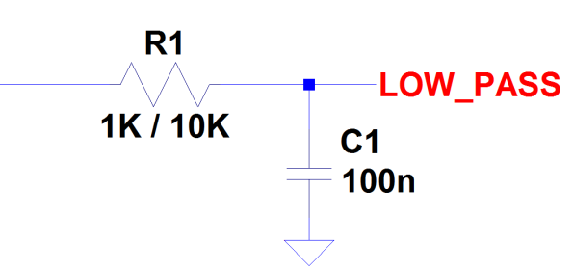
Experimental validation of characterisation technique
Using plain PC sound card at 96KHz sampling rate
Microphone input buffered with an op-amp
× Calculated
LP, τ=1E-3
LP, τ=1E-4
HP shelf
Accurate amplitude response
Accurate phase response, provided phase shift is 0 at f₀

Slide 9
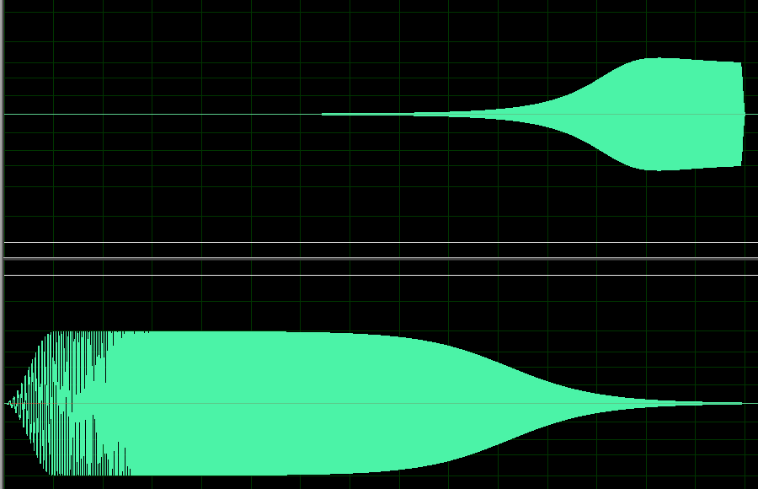
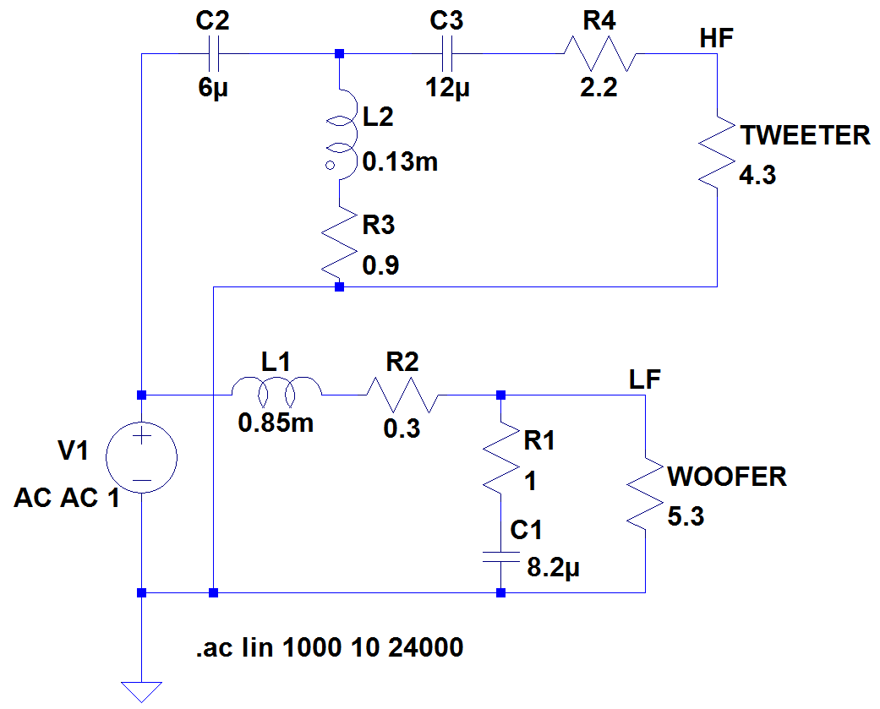


Design of the digital cross-over
Circuit – s plane – bilinear – impulse response - convolution
$$∗$$
L
TW
$$H\left(z\right)=\frac{0.0076+0.059z^{−1}−0.0017z^{−2}}{1−1.7935z^{−1}−0.8060z^{−2}}$$
Manually or using invfreqs
R
WOF
$$\frac{s\left(R_{w}C_{1}R_{1}\right)+R_{w}}{s^{2}\left(R_{w}L_{1}C_{1}+C_{1}R_{1}L_{1}\right)+s\left(R_{w}C_{1}R_{1}+L_{1}+0.3R_{w}C_{1}R_{1}+0.3C_{1}\right)+{(R}_{w}+0.3)}$$

Slide 10
Active vs. passive cross-over
×
Digital cross-over
L
TW
×
R
WOF
×
TW
× Calculated
Active
Passive
×
WOF
Measured at the drivers
Active cross-over allows to treat speaker drivers as resistances – simplifies filter design

Slide 11

Speaker driver characterisation
Digital cross-over
L
0.2m
TW
x(t)
R
0.2m
WOF

Slide 12
Loudspeaker response
1m
Digital cross-over
L
1m
TW
TW
x(t)
x(t)
WOF
R
WOF

Slide 13
Using the active cross-over to flatten speaker response
FIR correction only works well for high frequencies

Slide 14
Conclusion
Implemented and improved swept-sine technique for PC soundcards
Comparison of active and passive cross-overs
Active cross-over offer the same baseline performance, plus linear phase and ability to equalise high frequencies

